Slide 1

2024 BA-Eindwerkstuk Seminar
Werkgroep 102
May 05, 2024
Revising your way to final victory
Dr. Steven Denney

Slide 2
Today’s objectives
About the last few weeks
On Revision (review)
Revision practice (the Introduction)

Slide 3
About the last few weeks
You should focus on the following:
Getting feedback and meeting with your supervisor
Understanding your feedback and revising your manuscript
Finishing the full and final draft by the deadline
From next week until the end of this course, I will be available to meet online or in person. This is optional for you. See the sign-up sheet on BS.

Slide 4
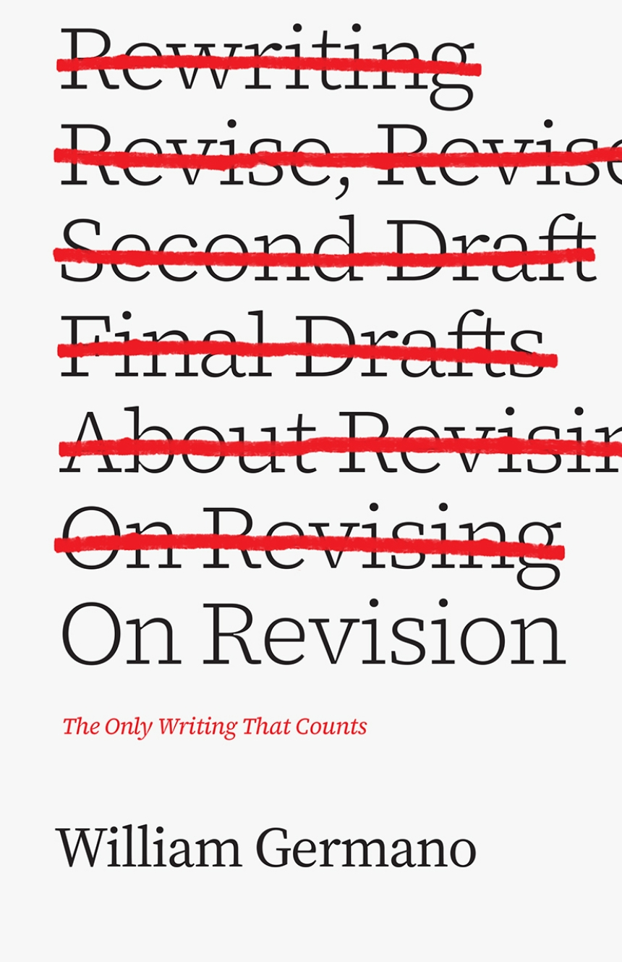

Slide 5
According to David Gooblar, what is revising a metaphor for?
According to David Gooblar, revising is a metaphor for learning. ​
It is a process of a new understanding, both for students revising their understanding of a subject and for writers revising their work. ​
Revising is also a metaphor for several other things, including thinking, a stage, dancing, and a journey. ​ It involves improving and refining writing to make it clearer, more persuasive, and more engaging for the reader.

Slide 6
What is the difference between correcting and revising?
The difference between correcting and revising lies in their scope and purpose. ​
Correcting focuses on fixing specific grammar, spelling, punctuation, or formatting errors while revising involves a broader approach to improving the writing's content, structure, and overall effectiveness.

Slide 7
How should writers respond to negative criticism?
Writers should respond to negative criticism by approaching it with an open mind and a willingness to learn and improve. ​
They should stay calm and objective, consider the source of the criticism, and separate it from their self-worth. Writers should look for constructive feedback, reflect on the criticism, and seek additional opinions if needed. ​ They should maintain their own voice while being open to making changes and improvements based on the feedback.

Slide 8
What principles are applicable to revision?
According to Wayne Booth and Gregory Colomb, the principles applicable to revision include seeing writing as a process, recognizing the importance of feedback, emphasizing clarity and coherence, considering the needs and expectations of the audience, engaging in self-reflection and self-critique, and practicing iterative revision.

Slide 9
More principles!
Correcting is not revising. ​
Writing is thinking.
Good writing is persuasive writing.
​We live in a world of data and narrative.
Look for the good kind of difficult. ​​
We want the good kind of problem. ​
Every text is a stage. ​
Don't undervalue instinct.
Listen to others, even when it hurts. ​

Slide 10
Revision practice
The Introduction

Slide 11
What makes a good introduction?
The research question (WHAT)
The research 'problem' and the gap (WHY)
The research plan and method (HOW)
Main claim(s) (FINDING/THESIS)
Contribution to knowledge and the literature (CONTRIBUTION)
Roadmap (TAKE US THERE)

Slide 12
Revise your introduction!

